Slide 1

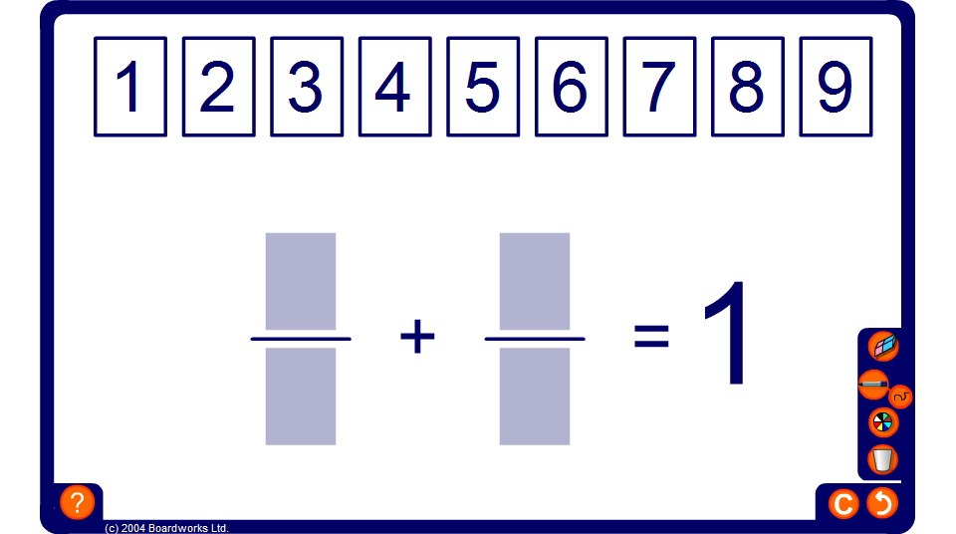


Drag and drop fraction sum
Notes:
Possible solutions are:
¹/₂ + ³/₆
¹/₂ + ⁴/₈
²/₄ + ³/₆
³/₆ + ⁴/₈
¹/₃ + ⁴/₆
³/₉ + ⁴/₆
¹/₄ + ⁶/₈
²/₈ + ³/₄

